Slide 1
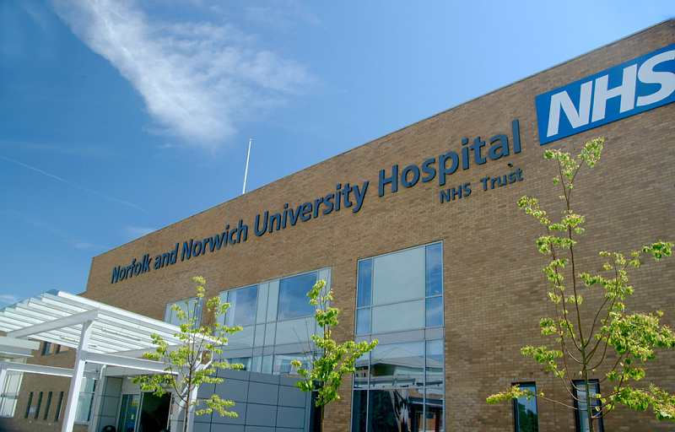
Norwich Oncoplastic
Breast Surgery Course
March 20th 2025 Thursday (Cadaveric dissection)
March 21st 2025 Friday (Live operative day)
Norfolk and Norwich University Hospital
Venue: Department of Anatomy, University of East Anglia and Norfolk and Norwich University Hospital
Course organiser: Mr Maged Hussien
Consultant Oncoplastic Breast Surgeon
Norfolk and Norwich University Hospital, Norwich

Slide 2
The Norfolk and Norwich University hospital has delivered an Oncoplastic Breast surgery since 2005. The large population the service covers has enabled the team to develop a wealth of experience covering all aspects of oncoplastic breast and reconstructive surgery from simple breast reshaping to complex free tissue transfer.
This two-day workshop is intended to be a comprehensive course on oncoplastic techniques and reconstruction excluding free tissue transfer. On the first day, the delegates will have multiple presentations and interactive tutorials with faculty. These will be combined with practical hands-on cadaver dissection by the delegates undertaking the various techniques. The second day will provide live demonstration of multiple oncoplastic operations in theatre.
The course is aimed at Surgical trainees, staff grade surgeons and consultants who are interested to develop their experience in these techniques and add them to their practice. We have applied for CPD accreditation from The Royal College of Surgeons of Edinburgh.

Slide 3
Provisional Program: Day 1
Department of Anatomy, University of East Anglia
07:30 Registration and Coffee
08:00 Oncoplastic breast conserving surgery Mr. Maged Hussien
08:15 Practical anatomy of chest wall perforator flaps Miss. Adeline Rankin
08:30 LTAP and AICAP Mr. Maged Hussien
08:45 Prepectoral implant reconstruction Prof. Andrea Figus
09:00 LD and TDAP flap Mr Richard Haywood
09:30 Therapeutic mammoplasty/Reduction Miss. Anais Rosich-Medina
Coffee Break (10:00 – 10:30)
Cadaveric dissection All faculty
Group 1 and Group 2 (4 candidates per group)
11 :00 – 13:30 LICAP / AICAP
Therapeutic mammoplasty
13:30 Lunch
14:15 - 15:30 LD / TDAP flap
15:30 – 16:30 Prepectoral implant reconstruction
Summary and close: 16:30 – 17:30

Slide 4
Provisional Program: Day 2
Norfolk and Norwich University Hospital
07:30-12:30 All faculty
Markup session followed by live surgery
  Group 1: LICAP flap & Prepectoral implant reconstruction with ADM
  Group 2: Therapeutic Mammoplasty
13:00 Lunch
14:00-17:30 All faculty
Markup session followed by live surgery
  Group 2: LICAP flap & Prepectoral implant reconstruction with ADM
  Group 1: Therapeutic Mammoplasty

Slide 5
Information
Location: Day 1
Department of Anatomy
Norwich Medical School
Norwich Research Park
University of East Anglia
Norwich
NR4 7TJ
Location: Day 2
Breast Surgery Unit,
Norfolk and Norwich University Hospital
Colney Lane
Norwich
NR4 7UZ
Registration
The fee is £750 payable in
advance. The fee includes
refreshments, lunch and
delegates pack
Deadline for registration:
February 15th 2025
Accreditation
CPD for attending the 2 day
applied for the Royal College of
Surgeons of Edinburgh
Delegate numbers will be limited to 8 only per course
Please book early
To register and for further details contact: maged.hussien@nnuh.nhs.uk

Slide 6
Faculty
Mr Maged Hussien
  Consultant Oncoplastic Breast Surgeon, NNUH
Mr Richard Haywood
  Consultant Plastic and Reconstructive Surgeon, University of East Anglia and NNUH
Prof. Andrea Figus
  Professor of Plastic and Reconstructive Surgery, Università degli Studi di Cagliari, Italy
Mr. Guido Köhler
  Consultant Plastic and Reconstructive Surgeon, NNUH
Miss. Anais Rosich-Medina
  Consultant Plastic and Reconstructive surgeon, NNUH
Miss. Dhalia Masud
  Consultant Plastic and Reconstructive surgeon, NNUH
Miss. Adeline Rankin
  Consultant Oncoplastic Breast Surgeon, NNUH
Miss. Bahar Mirshekar-Syahkal
  Consultant Oncoplastic Breast Surgeon, NNUH
Mr. Sendhil Rajan
  Oncoplastic Breast Surgery Senior Registrar, NNUH

